Slide 1
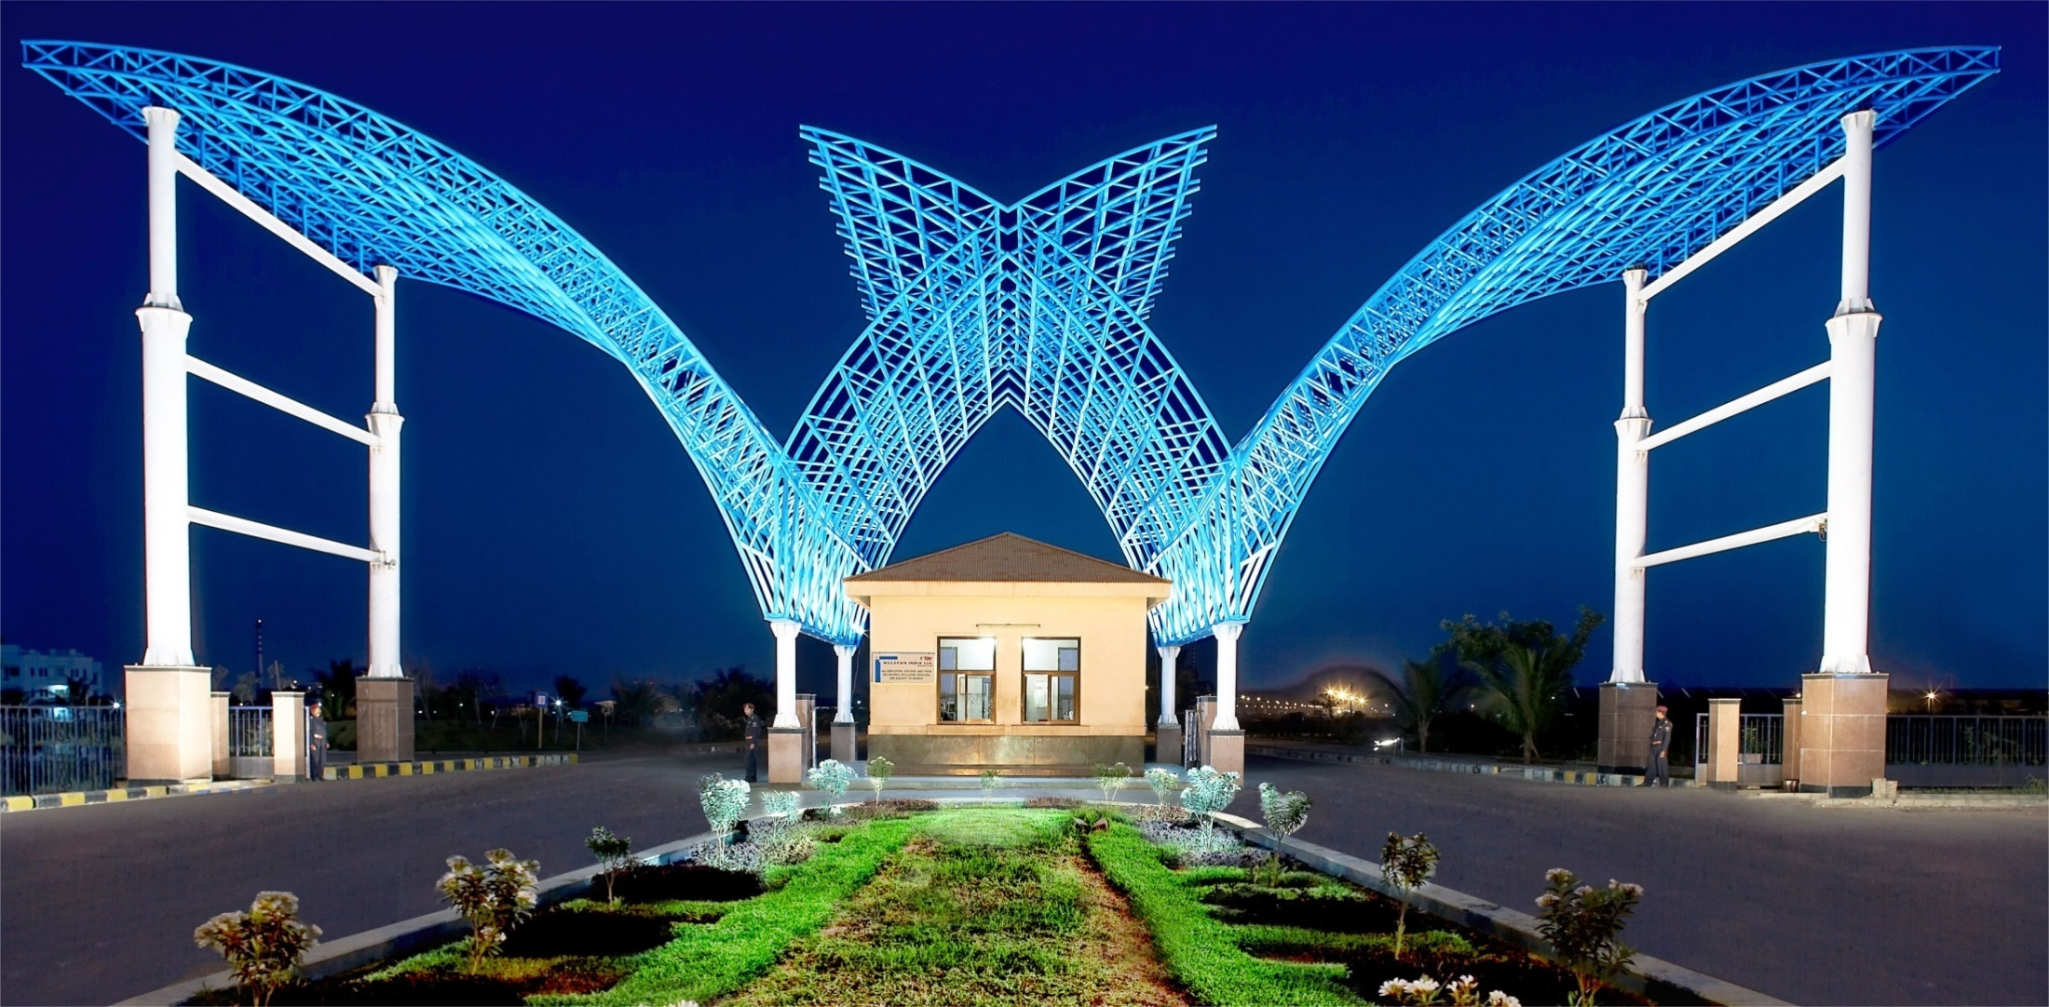
Energy Saving Sustainable Initiatives
Notes:
Logo - Use the appropriate business logo
Image Used -
Image should be changed according to the business.
Do not change the layout of the cover image.
No picture collage acceptable in the business image. Use only single image.
Title Font - Arial Bold
Title Font Size - 40
Colour (In RGB) - R 42, G 41, B 92
Month & Date Font - Arial
Month & Date Font Size - 16
Colour (In RGB) - R 42, G 41, B 92

Slide 2
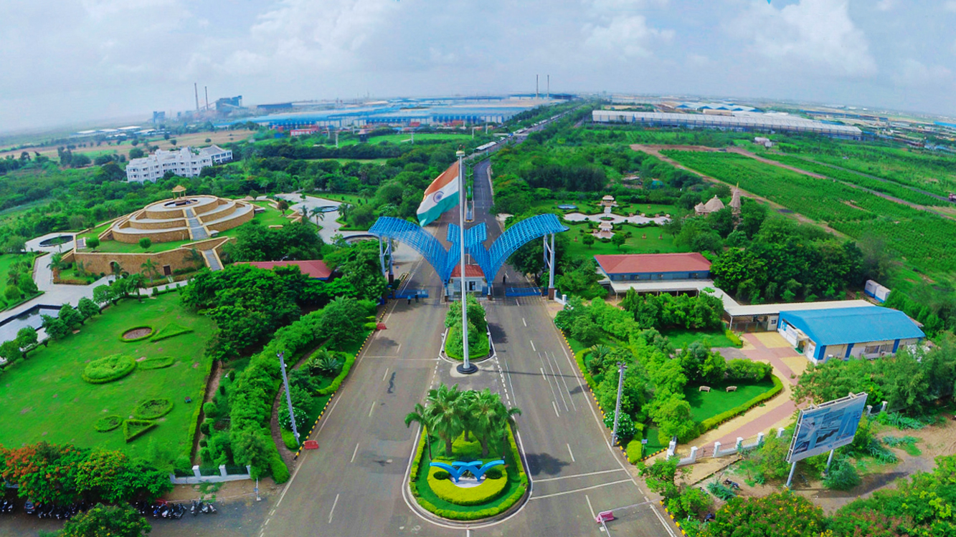
State of the art Manufacturing Facilities
Notes:
Logo - Use the appropriate business logo
Image Used -
Image should be changed according to the business.
Do not change the layout of the cover image.
No picture collage acceptable in the business image. Use only single image.
Title Font - Arial Bold
Title Font Size - 40
Colour (In RGB) - R 42, G 41, B 92
Month & Date Font - Arial
Month & Date Font Size - 16
Colour (In RGB) - R 42, G 41, B 92

Slide 3

Our Theme

Slide 4

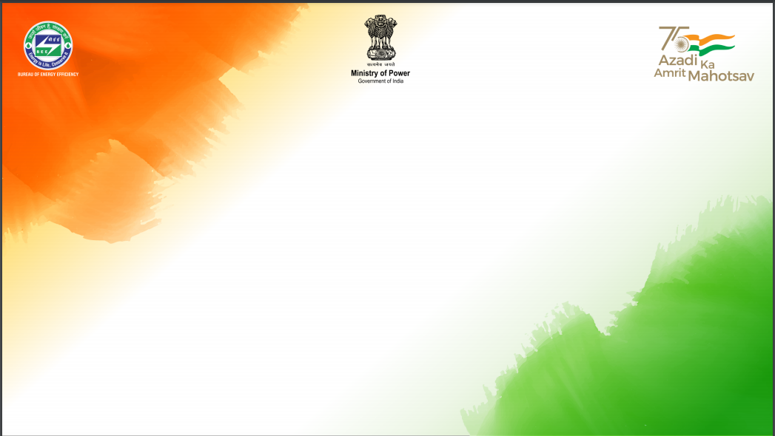
Energy Mapping Activity
Remark:
1st PAT Cycle completed in FY 19-20
SEC achieved 1.88 (Metric ton of oil Equivalent) MTOE/TON, reduction by 20.0 % over FY 19-20
Ecerts earned = 2085

Slide 5
Collaboration with Engineering Team for Energy Saving
SUMMARY ENERGY CONSERVATION PROJECTS
Sr. No. | Energy Savings | Unit | Annual Unit Savings | Amount Savings in Lakhs / Annum | Savings GHG Emission tCO2e
1 | Power Savings | Kwh | 5496375 | 0412.23 | 4507
2 | Coal Savings | MT | 25229 | 2270.61 | 46146
 | TOTAL |  |  | 2682.84 | 50653

Slide 6
Energy Conservation Project

Slide 7
Energy Conservation Project

Slide 8
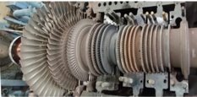
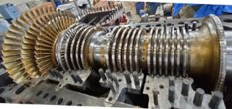
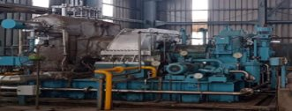
POWER PLANT: INTERNAL REPLACMENT OF TUBINE ROTOR TO ACHIVE ADDITIONAL MORE 2MW POWER WITH SAME FUEL.
Sustainable Initiative: | Technological up gradation of existing Steam Turbine to generate 22.35 % more power on same Qty of steam inlet to Turbine
Before: | 10.50 MW / Hr. power generation
After: | 12.45 MW / Hr. power generation
> Total investment. | Lakhs | 439
> Energy Saved | Coal MT/Day | 26.78
> Total Savings/year | Lakhs/Year | 860.58
Before
After
Project Site : 15MW Steam Turbine

Slide 9
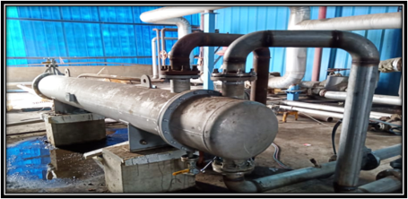
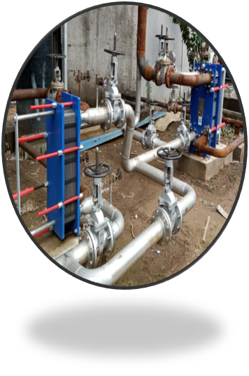
Department | ​UTILITY | ​
Sustainable Initiative | Installation of Waste Heat recovery ​mechanism in compressor, contaminated steam and flash heat and waste heat from Effluent.
Before: | ​Heat energy being found to be wasted in the Utility department.
After: | Installation of Heat recovery system on following​ > Compressor Heat recovery​ > Flash & Condensate Heat recovery​ > Effluent Heat recovery​ ​
> Total investment.​ | Lakhs | 74
Energy Saved | Coal MT / YEAR | 3920
Total Savings /Year | Lakhs | 352.79
Compressor Heat recovery
Flash & Condensate Heat recovery

Slide 10
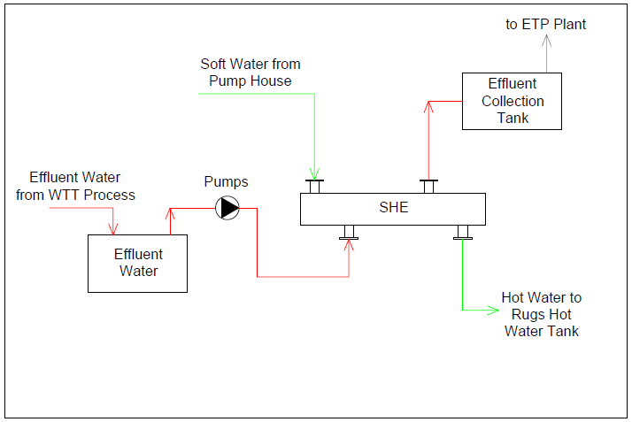
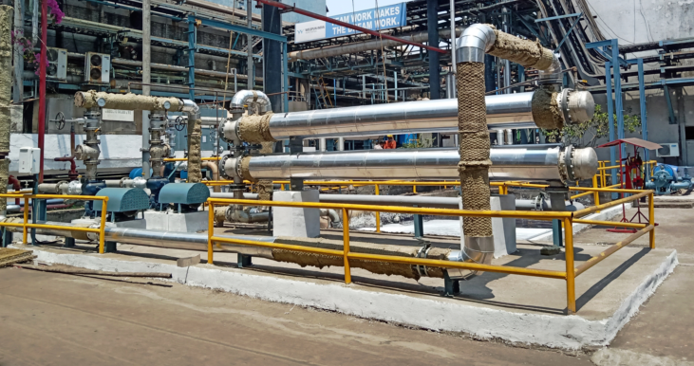
Process flow of Heat recovery system
Heat recovery system
Department. : Utility
Sustainable Initiative: | Rugs plant Hot water recovery from Effluent Heat (1000M3/Day)
> Total investment. | Lakhs | 64
> Energy Saved | Coal MT / Day | 7.46
> Total Saving/year | Lakhs | 239.58

Slide 11
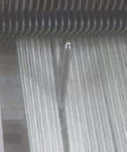
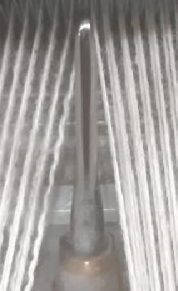
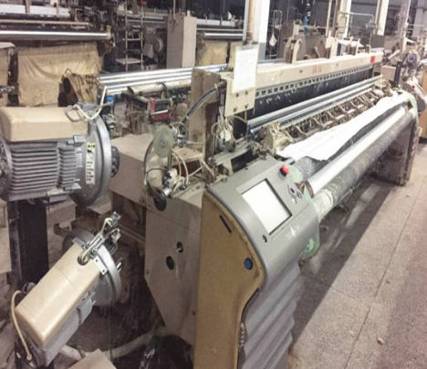
Plant/Dep’t. : Utility | Project
Title of the measure:→ | Reduction of Air consumptions by installing new version of air nozzle in Air jet Looms to save compressor power consumption.
Description After modification: → | Reduction in Air Consumption by 2184 CFM/Day. Air cost @ Rs 4.5 Kwh/CFM, Power Savings 9000 Kwh/Day.
> Total investment. | INR LAKHS | 321
> Pay back period | ROI | 1.95 Years
> Energy Saved | Power KWH/DAY | 9000
> Energy tariff | INR / KWH | 7.50
> Total amount Saving | LAKHS / YEAR | 240.98
Air jet Nozzle
Air jet Looms

Slide 12
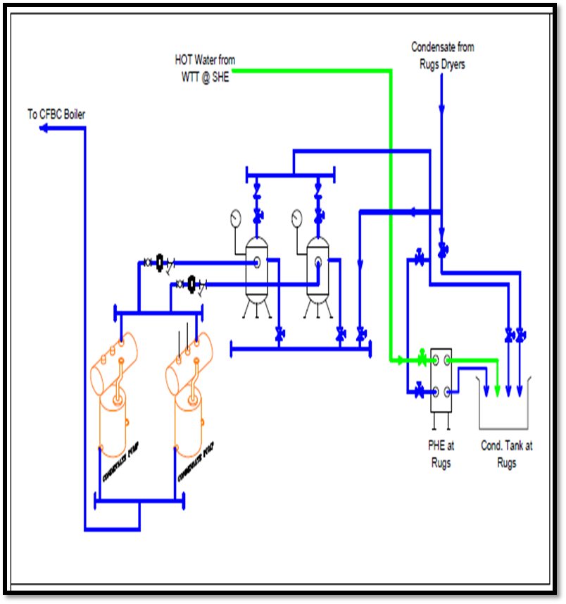
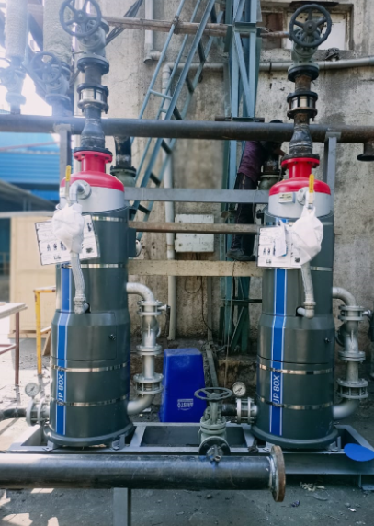
TECHNOLOGY
Plant/Dep’t. | UTILITY
Title of the measure:→ | Process-2, Condensate water recovery from indirect heating area in plant and feed to Power plant.
Description After modification: → | Installation of FJP (Flash Jet Pump)
> Total investment. | Lakhs | 65.00 Lakhs
> Pay back Month / Year | Months | 6 Months
> Energy Saved | Coal MT / DAY | 4.41
> Energy tariff | INR / MT | 9000
> Total amount Saving | LAKHS / YEAR | 141.84
Process flow
Site Photo
Condensate Water Recovery System

Slide 13
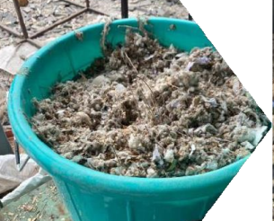
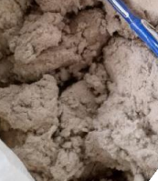
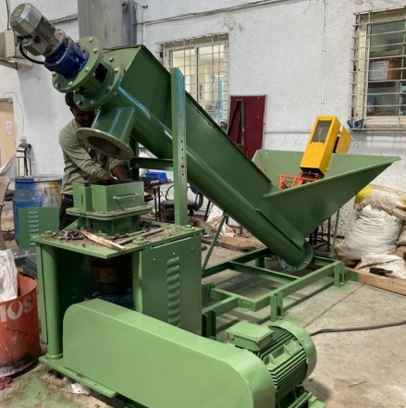
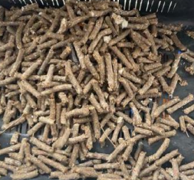
Department: | Power Plant
Sustainable initiative: | Installation of Waste Pelleting machine for cotton and blow room waste and use as Bio-Coal.
Before: | Cotton waste generated was dumped in landfill or remain untilized.
After | Converting Waste material in to Pelleting form and use as Biomass fuel in Boiler and reducing the consumption of coal
> Total investment. | Lakhs | 22157
> Energy Saved | Coal MT / Day | 0.500
> Total Savings/year | Lakhs | 132.9
Cotton Waste during manufacturing
Product Output
(Biomass)
Waste Pelleting M/c

Slide 14
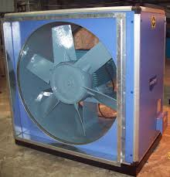
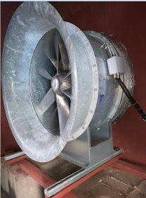
Sustainable Initiative | Power savings in Humidification Plant - 7 A at Finish Folding by Installing NOVENCO high efficient Supply Air Fan.
Before | Actual Power consumption of Supply air Fan is 57.5 KW against Installed Power of 75Kw.(Power Consumption 1380 Kwh / Day)
After | We have installed 44 KW Supply Air FAN instead of 75 KW. And actual KW is observed 34.5 with maintaining required air volume with optimum frequency Power Consumption 828 Kwh / Day)
> Power consumption before modification | Kwh / Day | 1380
> Power consumption after modification | Kwh / Day | 828
Energy Saved | Kwh / Day | 552
Total Savings/year | Lakhs/year | 14.78
Before
After
After
Novenco Power efficient Fans

Slide 15
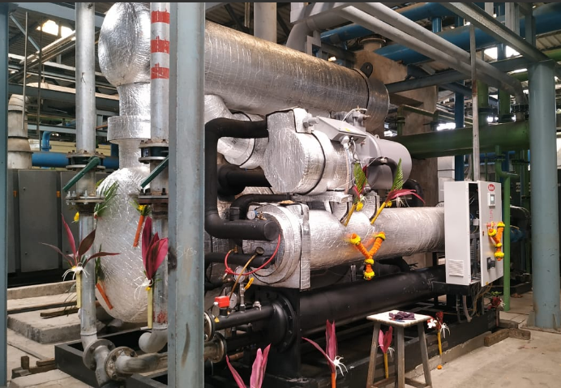
Energy savings in 2022-23
Plant/Dep’t. : | UTILITY
Title of the measure:→ | Replacement t of Refrigerant Air dryer with Glycol based Thermal fly wheel refrigerated type compressed air dryer .Capacity 16000 CFM
Description Before modification:→ | Power Consumption 1900 Kwh/day
Description After modification: → | Power Consumption 980 Kwh/day
> Total investment. | INR LAKHS | 53.00
> Pay back period | MONTHS | 26
> Energy Saved | Power KWH/DAY | 920
> Energy tariff | INR / KWH | 7.50
> Total amount Saving | LAKHS / YEAR | 24.63
New Shalkoot Dryer
Capacity : 16000 CFM

Slide 16
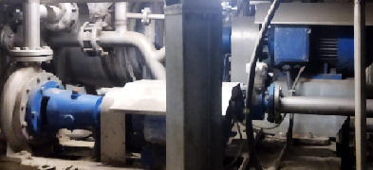
TECHNOLOGY
Plant/Dep’t. | PROCESS HOUSE
Title of the measure:→ | Reduction of Pump speed in Brazoli Fabric dyeing machine based on recipes.
Description Before modification:→ | Liquor pump speed 1350 RPM
Description After modification: → | Liquor pump speed Optimisation against 1350 RPM it varies from 1000 to 1200 based on Shade depth.
> Total investment. | INR | 0.00
> Pay back Month / Year
> Energy Saved | KWH / DAY | 1500
> Energy tariff | INR / KWH | 7.5
> Total amount Saving | LAKHS / YEAR | 40.16
PUMP

Slide 17
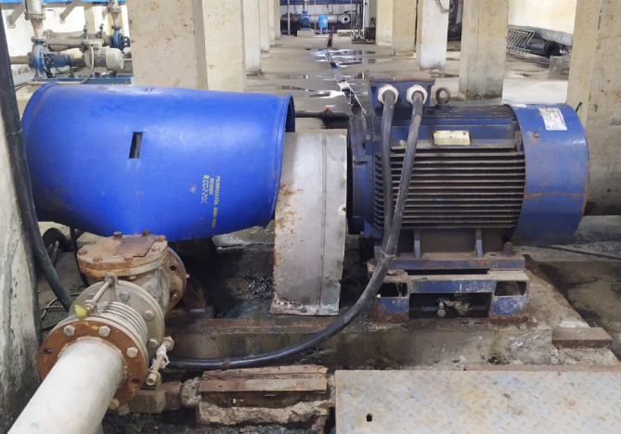
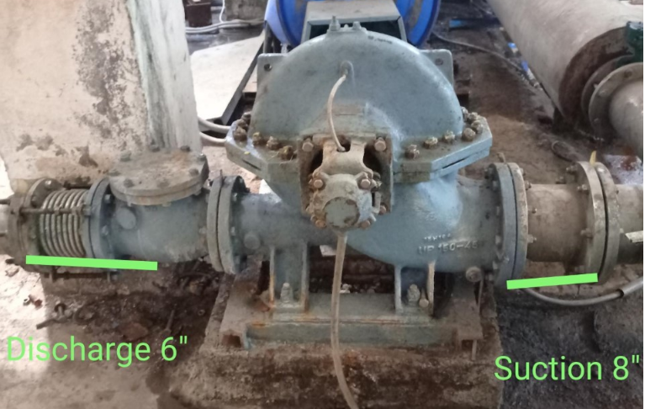
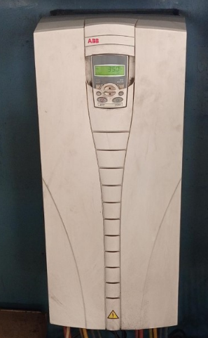
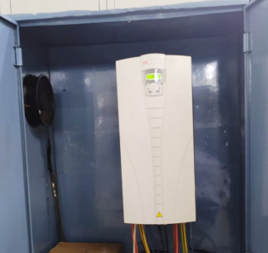
TECHNOLOGY
Plant/Dep’t. | ET PLANT
Title of the measure:→ | Energy saving by regulating pump discharge flow through VFD drive.
Description Before modification:→ | The 90 KW pumps were selected to discharge in deep sea at high head. But presently working head is low and flow discharge was high and pump got tripped at full valve open. So to reduce current valve throttling was must.
Description After modification: → | Now the pumps operated through VFD to control flow and current. Now pumps are in operation with full valve open with reduce RPM. Resulting saving in power consumption
> Total investment. | INR LAKHS | 1.65
> Pay back month/year | MONTH/YR | 0.08
> Energy consumption before | KWH / DAY | 1750
> Energy consumption after | KWH / DAY | 950
> Energy Saved | KWH / DAY | 800
> Energy tariff | INR / KWH | 7.50
> Total amount Saving | LAKHS / YEAR | 21.42
Before
SEA DISCHARGE PUMP
Discharge Pump
After
VFD DRIVE

Slide 18
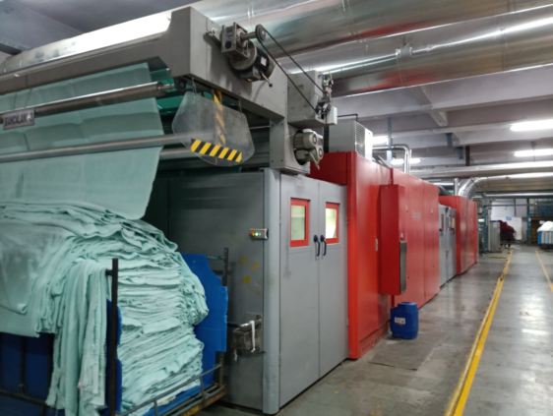
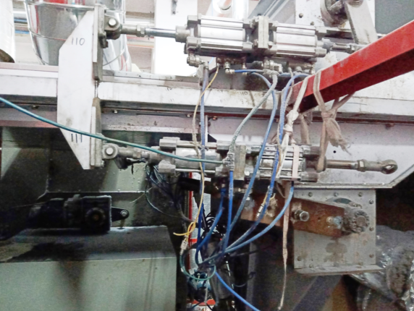
TECHNOLOGY
Before
Plant/Dep’t. | PROCESS HOUSE.
Title of the measure:→ | Energy saving by Modification in tumbling cylinder operation process in Bianclani m/c ( Fabric Dryer).
Description Before modification:→ | In Biancalani Dryer or tumbling function for one movement it was equipped with 8 cylinder and 5 valves Pneumatic system operates by 5 Valve operation
Description After modification: → | It was modified with 2 cylinder and 2 valves for this function, which reduce the air consumption by 16 cfm/machine. Total reduction in Air Consumption = 80CFM for 5 Nos m/c and Power consumption of Air = 4.4 Kwh / CFM, hence power saving 360 Kwh / Day
> Total investment. | INR LAKHS | 4.27
> Pay back month/year | YEAR | 0.44
> Energy consumption before | KWH / DAY | 5770
> Energy consumption after | KWH / DAY | 5410
> Energy Savings | KWH / DAY | 360
> Energy tariff | INR / KWH | 7.50
> Total amount Saving | LAKHS / YEAR | 9.64
Before
Machine Dryer
After
Modified tumbling assembly

Slide 19
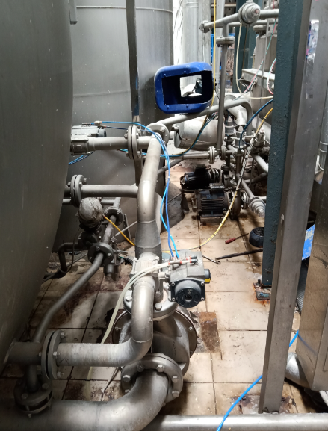
TECHNOLOGY
Plant/Dep’t. | PROCESS HOUSE.
Title of the measure:→ | Brazzoli machine : Reduce MIXING operation time for the product which dose not need this function.
Description Before modification:→ | When chemical enter in to tank, mixing of chemical carried out, It was set at 20% level of tank, Power consumption was 100kwh / day. (1.5Hr/Batch x 2.2 Kwh x 50 Batch / Day = 165 kwh / Day consumption)
Description After modification: → | We modify the mixing start up system to increase level of tank from 20% to 40%, (1Hr/Batch x 2.2 Kwh x 50 Batch / Day = 110 kwh / Day consumption), considering 50 Kwh saving / day
> Total investment. | INR | Nil
> Pay back month/year | MONTH/YR
> Energy consumption before | KWH / DAY | 165
> Energy consumption after | KWH / DAY | 110
> Energy Savings | KWH / DAY | 50
> Energy tariff | INR / KWH | 7.50
> Total amount Saving | LAKHS / YEAR | 1.34
Dosing unit of Fabric Dyeing m/c

Slide 20
TECHNOLOGY
Plant/Dep’t. | PROCESS HOUSE.
Title of the measure:→ | Brazzoli machine : Reduce Recirculation Pump operation time.
Description Before modification:→ | In Dyeing Machine re-circulation function was running while chemical injection for better mixing of chemicals. It was observed that some unnecessary running of this pump for more time. Earlier it was running 90 min/batch (1.5Hr/Batch x 5 Kwh x 50 Batch / Day = 375 kwh / Day consumption)
Description After modification: → | reduced the running time of re circulation pump when fluid is enter in to vessel up to set value, We reduce running of this pump to 75 min, so we got saving of 15 min/batch (1.25Hr / Batch x 5 Kwh x 50 Batch / Day = 375 kwh / Day consumption)
> Total investment. | INR | Nil
> Energy consumption before | KWH / DAY | 375
> Energy consumption after | KWH / DAY | 312.5
> Energy Savings | KWH / DAY | 60
> Energy tariff | INR / KWH | 7.50
> Total amount Saving | LAKHS / YEAR | 1.61
Recirculation unit of Fabric Dyeing m/c

Slide 21
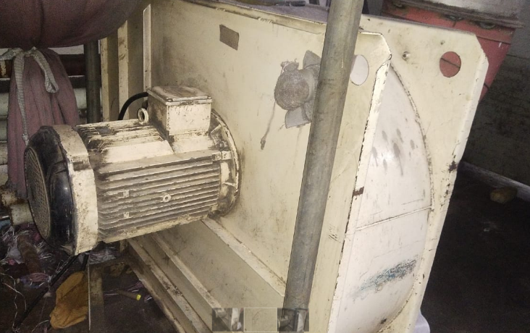
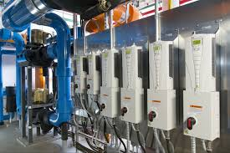
Energy Conservation Project
Plant/Dep’t. | PROCESS HOUSE.
Sustainable Initiative: | Power saving at blower unit in Xetma Shearing machine by installing VFD.
Before: | In Xetma Shearing 22 kw Exhaust blower drive was running on star-delta starter, In running it was taking 28 amp and running of 21 hrs/day (22 KW, 28AMP x 21 Hrs = 359 kwh / day power consumption)
After: | Installed AC Drive for this operation and due to this current reduce to 21 amp, so that got the 7 amp saving.
> Power consumption before | KWH / DAY | 359
> Power consumption after | KWH / DAY | 269
> Enegy Saved | KWH / DAY | 90
Total Savings/year | Lakhs | 2.41
Before
22 KW blower drive
After
AC drive

Slide 22
TECHNOLOGY
Plant/Dep’t. | PROCESS HOUSE.
Title of the measure:→ | Reduction of Pump speed in Yarn Dyeing machine in non critical qualities.
Description Before modification:→ | Liquor pump speed 1450RPM
Description After modification: → | Liquor pump speed Optimisation against 1450RPM, for I-O step 1300RPM & O-Istep 1160RPM
> Total investment. | INR | 0.00
> Energy Saved | KWH / DAY | 409.6
> Energy tariff | INR / KWH | 7.5
> Total amount Saving | LAKHS / YEAR | 10.97
PUMP

Slide 23
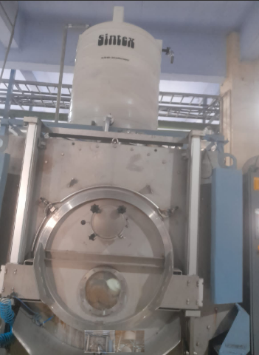
> M/c Modification / New Development
Plant/Dep’t. : Rugs Process | RUGS PROCESS
Title of the measure:→ | Water recovery in EZM Rugs dyeing Machine. 3KL Tank installation for EZM dyeing – 3KL Cap.
Description Before modification:→
Description After modification: → | Savings of Water Cost 16.32 Lakhs (Water Savings 64667 KL/Year.) Savings of chemical Cost Rs 31.77 Lakhs Power Cost Rs 8.88 Lakhs
> Total investment. | INR LAKHS | 58.52
 | ROI | 18 MONTHS
> Total amount Saving | LAKHS / YEAR | 39.21
Remark:-
Picture : 3KL Tank installation over EZM Dyeing m/c

Slide 24
LOOKING FORWARD TO ACHIEVE MANY MORE MILESTONES AHEAD
THANK YOU.

